Slide 1
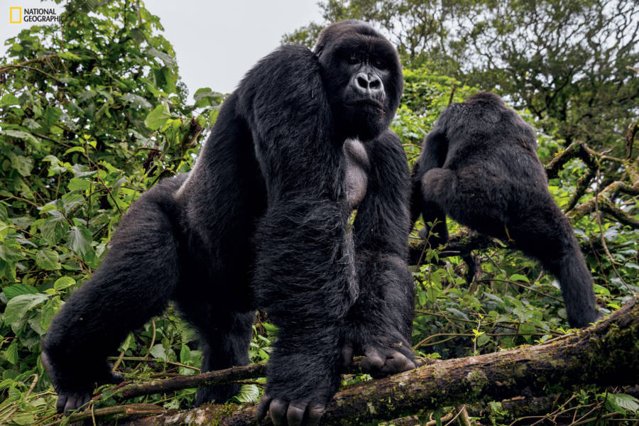
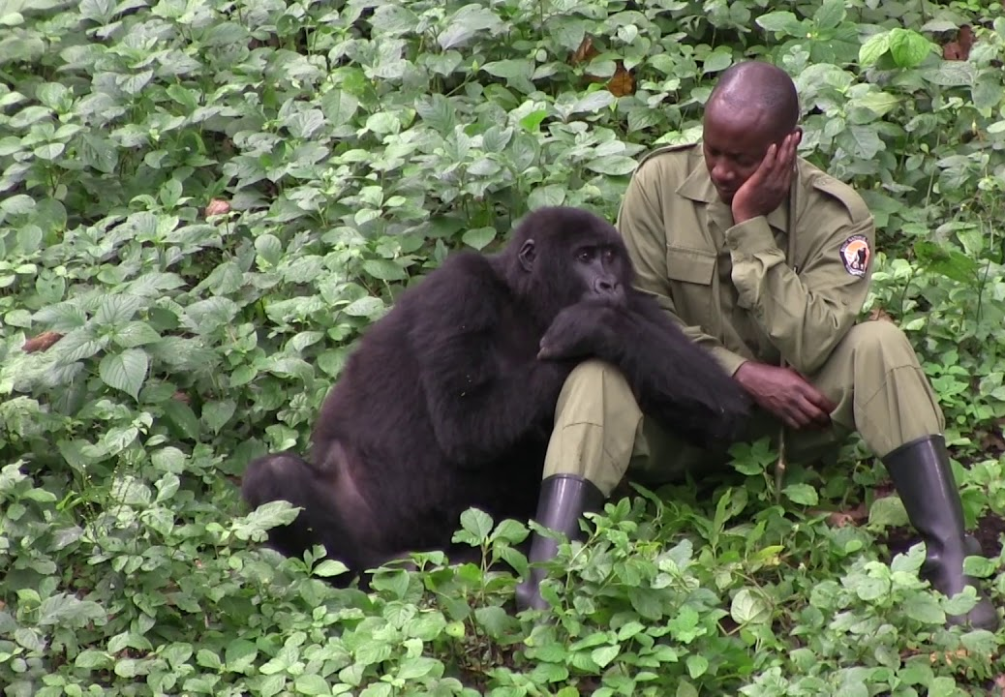

Slide 2
The Workshop Brief
Virunga.org
Goals & objectives Find out what it is, what’s his purpose and create a dedicated content marketing case speaking to the appropriate audience & telling the right story. → elevator pitch → with elements from the CM Periodic Table you’ll use?
Notes:
2h + 15min Case Presentation

Slide 3
The Persona
Virunga.org
Develop 3, focus on one Identify 3 personas but you must select only one to focus on for your content strategy. → practical experience in researching, creating, and applying these personas to a real-world scenario.
Notes:
2h + 15min Case Presentation

Slide 4
6 Principles of Stickiness
Simple → Keep it simple and profound
Unexpected → Surprise your audience.
Concrete → Use concrete images
Credible → Help people test your ideas for themselves.
Emotional → Tap into emotions to convey your point. We’re wired to feel things for people, not abstractions.
Stories → Tell stories to get people to act on your ideas.

Slide 5
