Slide 1

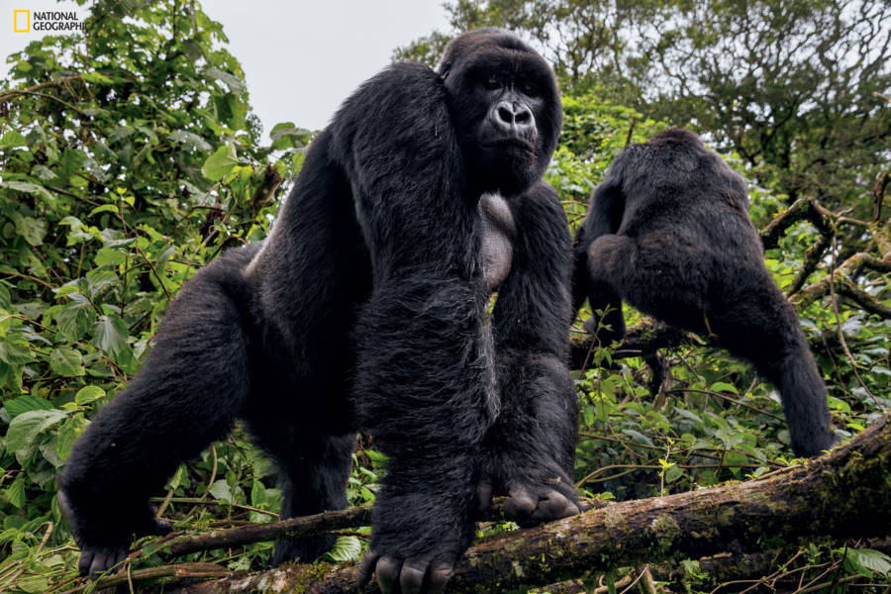


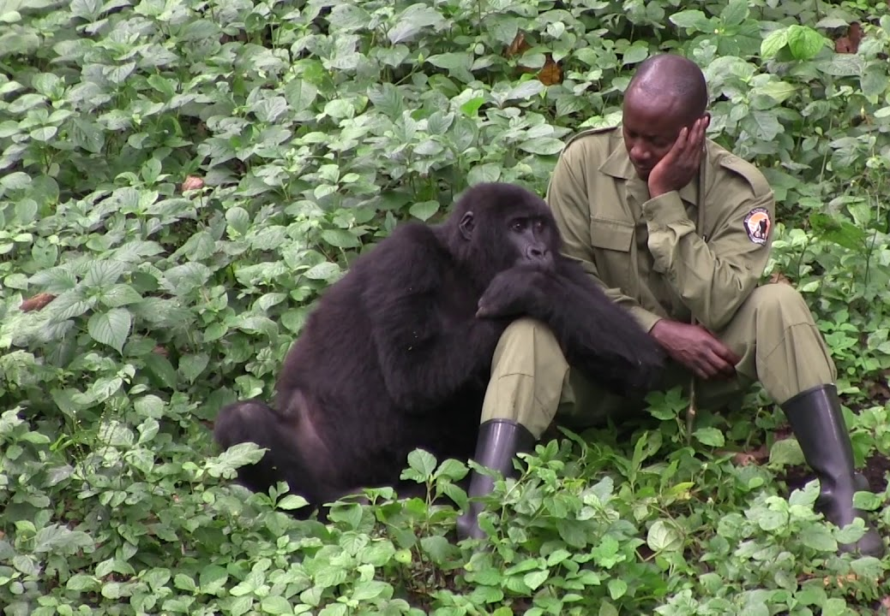


Slide 2
The Workshop Brief
Virunga.org
Goals & objectives
Find out what it is, what’s his purpose and create a dedicated content marketing case speaking to the appropriate audience & telling the right story.
→ elevator pitch
→ with elements from the CM Periodic Table you’ll use?
Notes:
2h + 15min Case Presentation

Slide 3
6 Principles of Stickiness
Simple → Keep it simple and profound
Unexpected → Surprise your audience.
Concrete → Use concrete images
Credible → Help people test your ideas for themselves.
Emotional → Tap into emotions to convey your point.
We’re wired to feel things for people, not abstractions.
Stories → Tell stories to get people to act on your ideas.

Slide 4
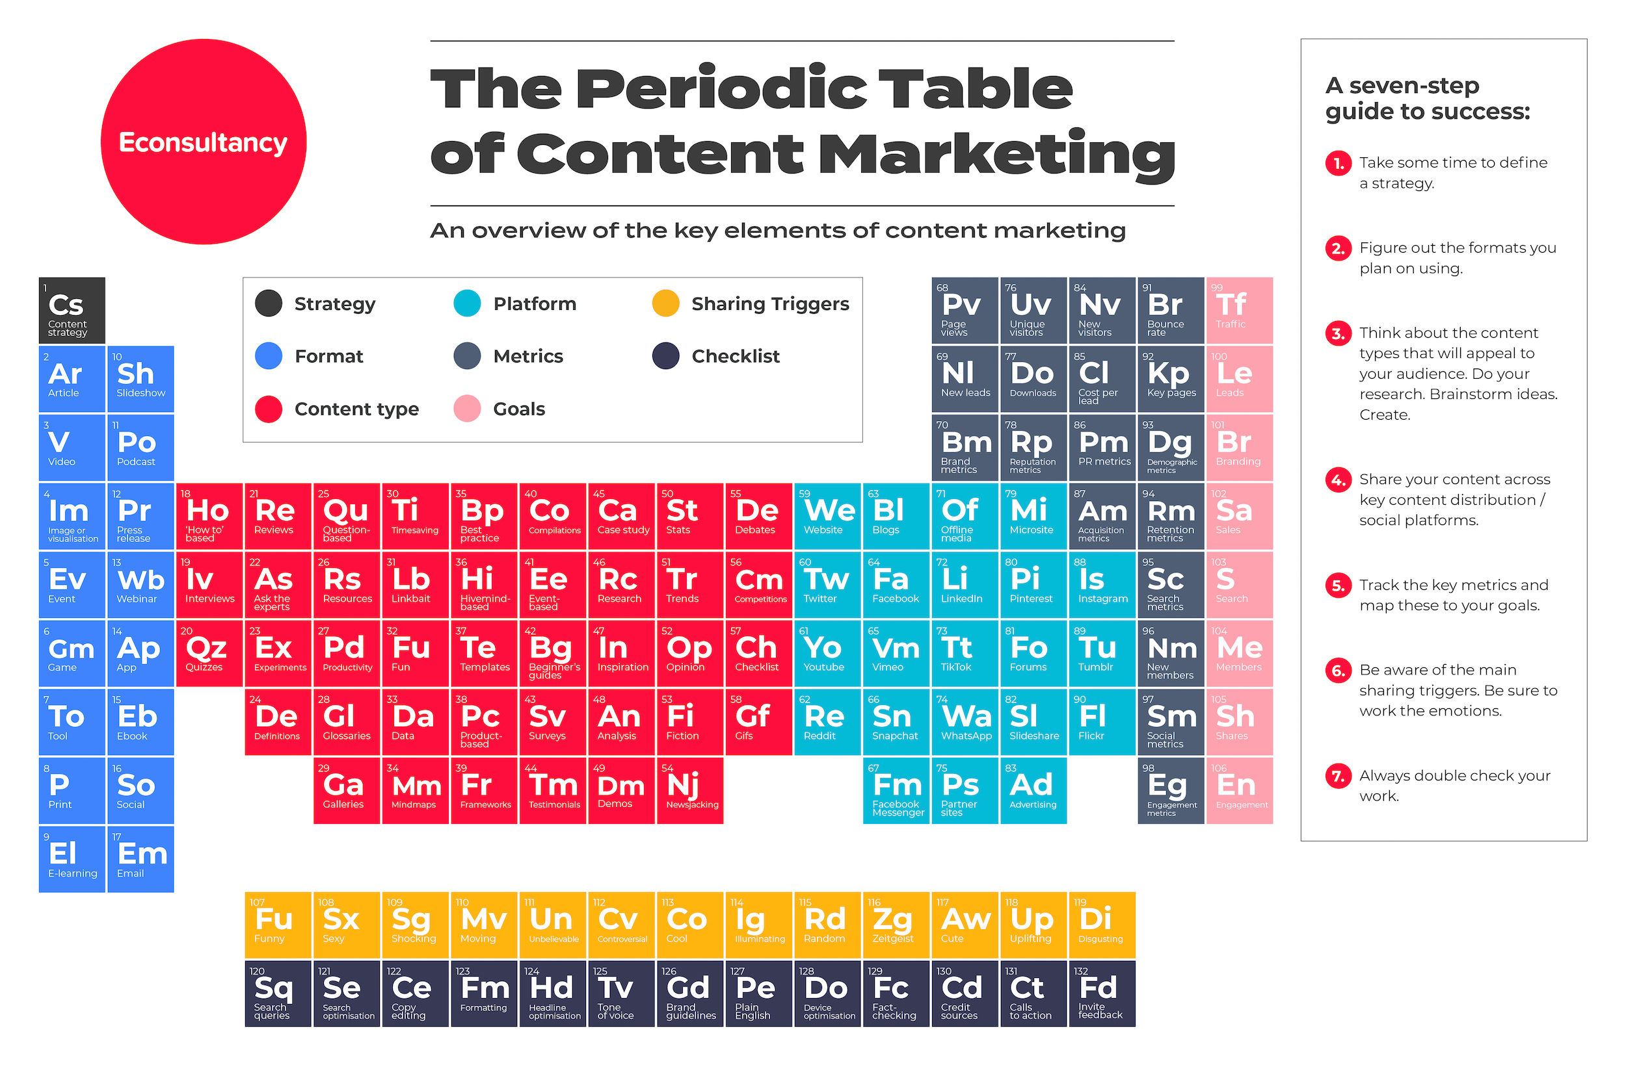

Slide 5


